Slide 1

Notes:
Hi Everyone,
Good Morning
Before we start with the presentation today, I would like to share a small recital.
We have been a part of Publicis Sapient for almost 3months now, and there is this fact that everyone of us would agree upon.
We all started as fresh graduates, underwent 5weeks or so of rigorous training followed by what…5 weeks now of a Hands On project, and what has transpired in these days is a fact that we all are really proud of. A transformation from someone who could code, to someone who can not only code, but add value to everything he does.
So have we succeeded at becoming a Product engineer?
Hi, I am Rajat, a small part of our big team here.
I am here with my colleagues Aman and Chinmay and we are here to give you a walkthrough of our Transformation, our Journey and the project we have been working for sometime now.

Slide 2
1
The Ask – Where we started?
…..

Slide 3
Framework for 1.5 Weeks
1.5 weeks plan
EveryDay Discussion about topics / Technologies / doubt clearance .
Every day with SME/Trainer discussion of Project progress and transformation based on UML and Technologies

Slide 4
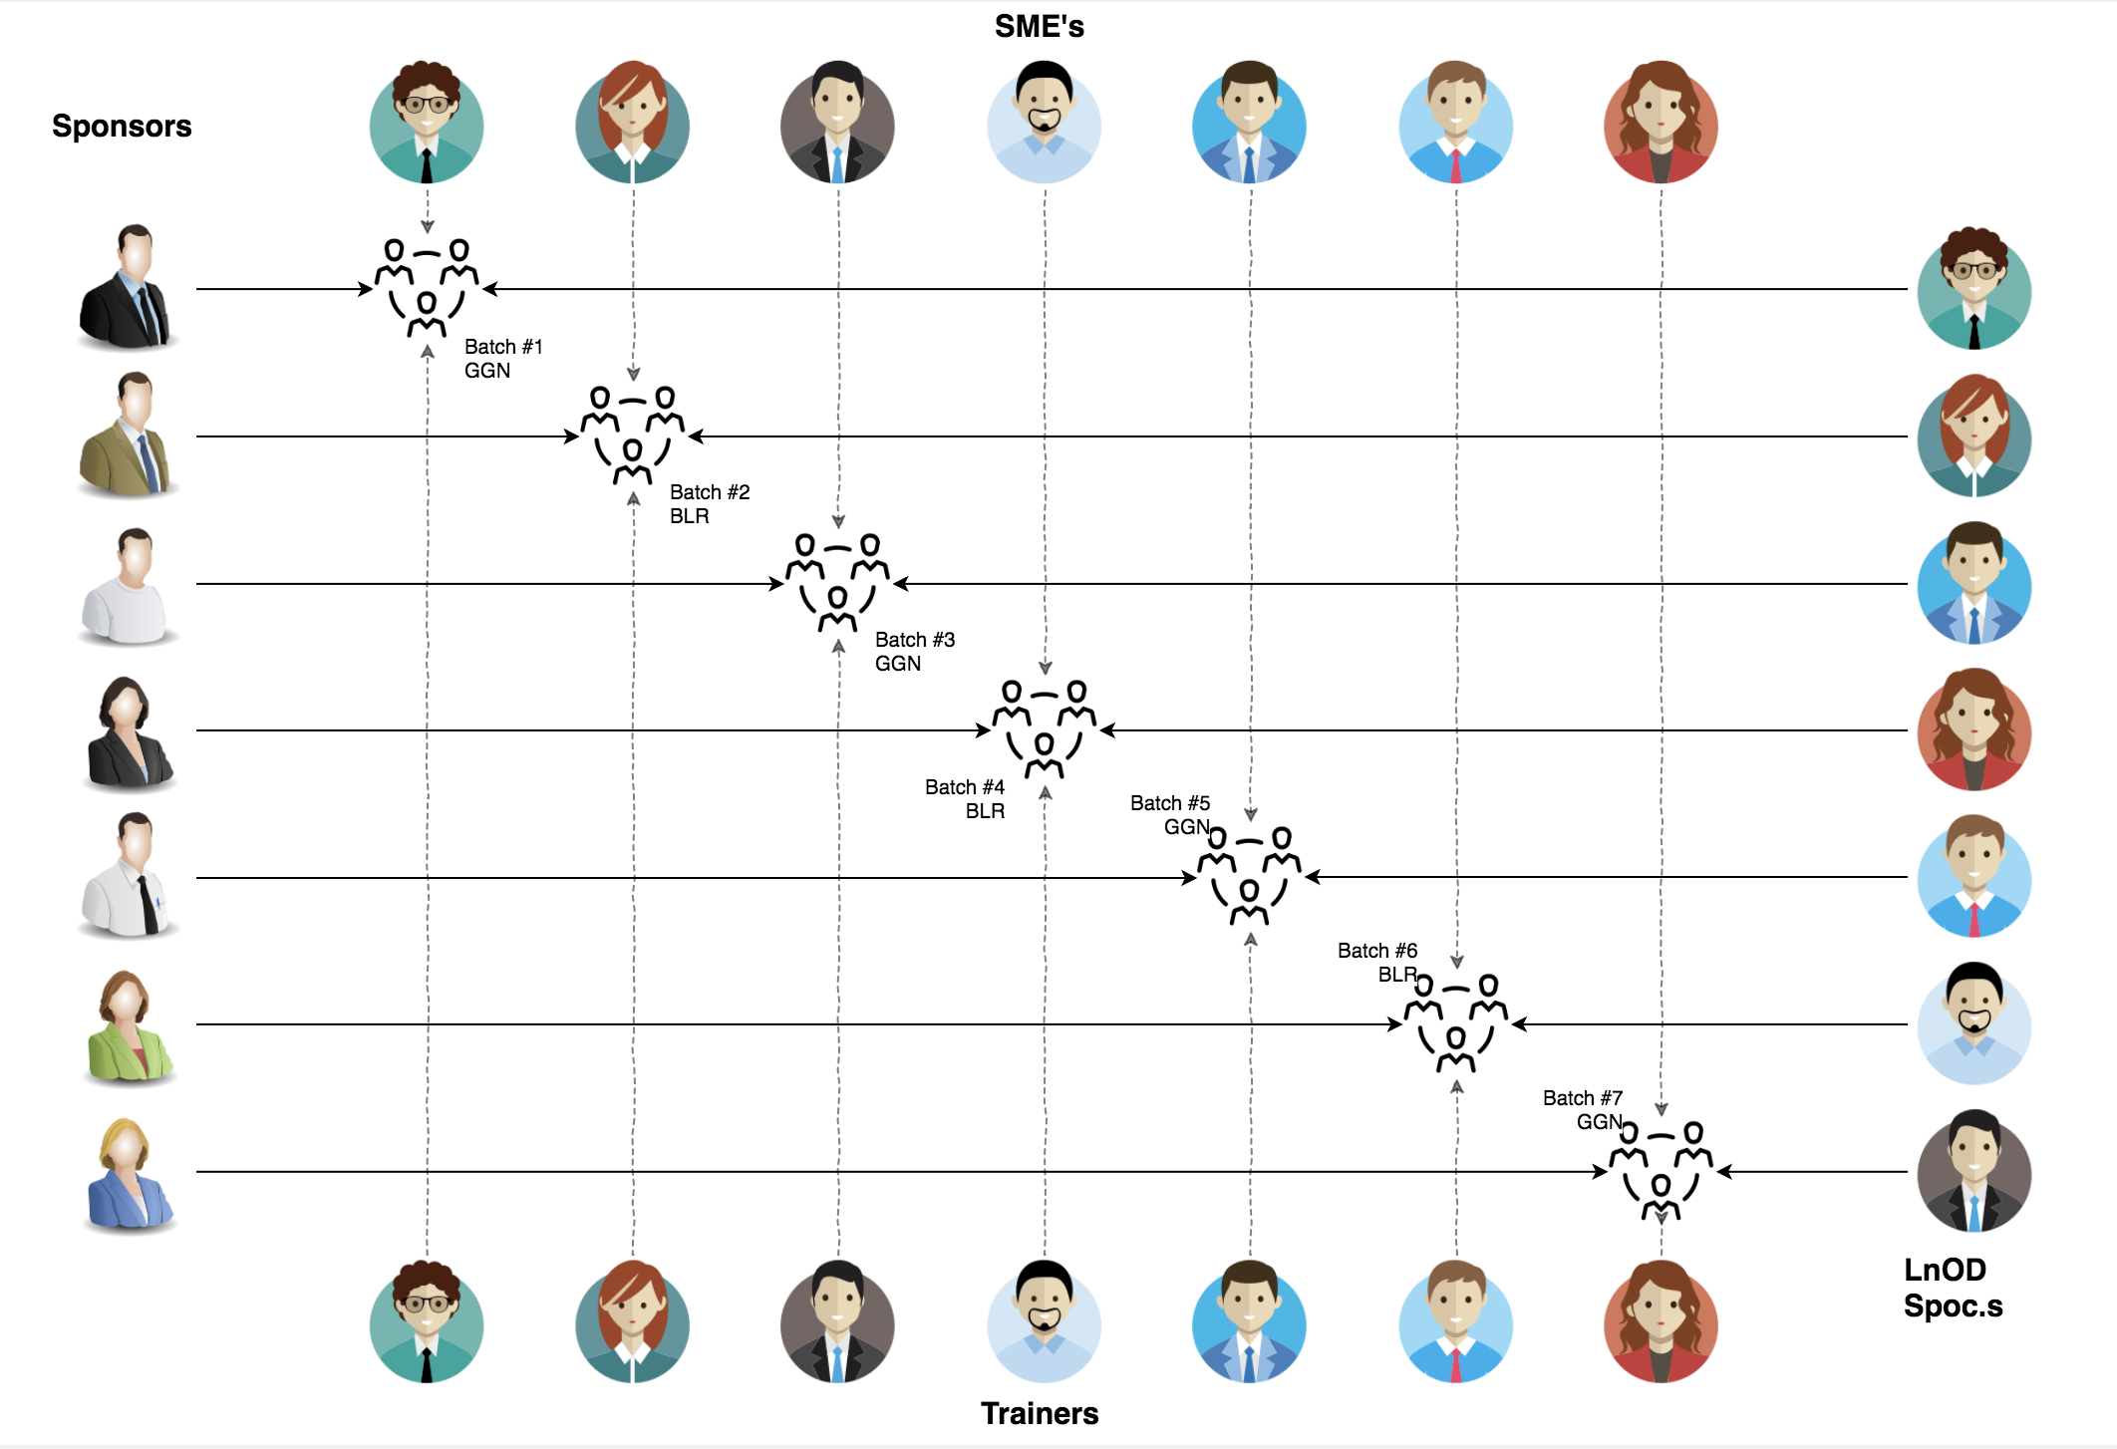
Stakeholders
Sponsors
-TCS
SME’s
-Amit Balyan
Coordinators
- Prudhvi Raj Bhashakarla

Slide 5
Our next starts
NOW
Notes:
Time – 1 min
Swati

Slide 6
1.5 WEEKS OF TRAINING + PROJECT DEMO
10 DAYS
90 HOURS
5,400 MINUTES
3,24,000 SECONDS
LIMITLESS KNOWLEDGE

Slide 7

Agenda
01
Our Journey
02
Our Team
03
Team Structure
04
Project Goals
05
Engineering Practices
06
Tech Stack
07
Development
08
Challenges & Learnings
09
Demo
10
Questions
Notes:
Time – 1 min

Slide 8

Our Journey
Our journey started for developing a project for a given case study crs(course registration system) with spring boot framework on eclipse ide for designing an api for crsand connecting to database.And then we converted our project from monolithic architecture to microservice using eureka server netflix oss.
Notes:
Time - 2 mins

Slide 9
Demo
Mindset
Process
5
project Demo
Tools
4
Adapting to a developer
Mindset
Comprehend
3
Design Thinking
2
Decide the Technologies JAVA/REST
1
Understanding Project Goals

Slide 10

Our Team
Notes:
Time – 2 mins

Slide 11


Avinash Gupta
Ashwiny Prakash
Ganesh p
Sai Manaswini
Sandhya Gayatri

Slide 12

Team Structure
Developers:
-Avinash Gupta
-Ashwiny Prakash
Database Design:
-Ganesh P
Artifacts Design:
-Sai Manaswini
-Sandhya Gayatri
-
Notes:
Time – 2 mins

Slide 13

Project Goals
To develop a CRS(course registration system) using microservice architecture
Notes:
Time – 3 mins

Slide 14




Our Vision
To create a Course Registration System using JAVA/REST tools and technologies, where a professor as well as a student can view courses and enroll in some of the courses.
1
2
Quality
Security
3
4
Interactivity
Speed
Notes:
User satisfaction and brand value

Slide 15

ENGINEERING PRACTICES
JAVA TOOLS
UML ARTIFACTS
GIT REPOSITORY
DATABASE DESIGN
Notes:
Time – 5 mins

Slide 16
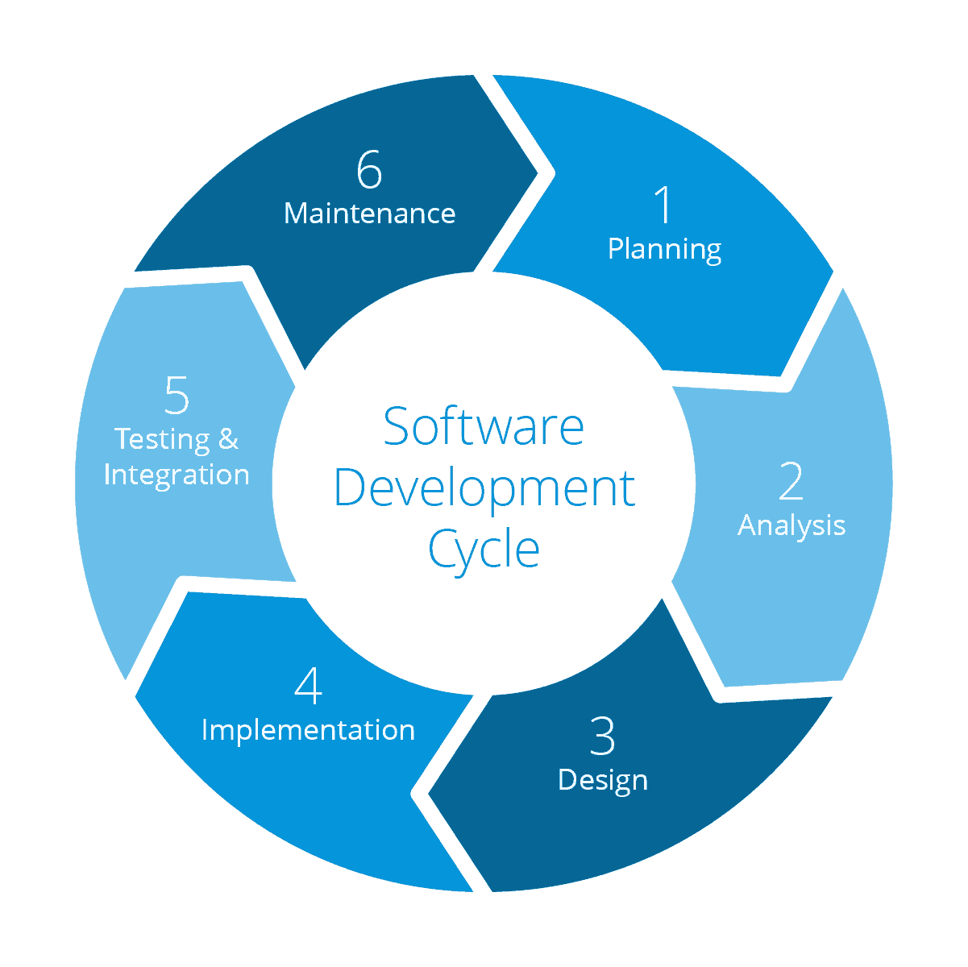
Requirement gathering
System Testing
Technology stack selection
Code implementation and development
UML artifacts design

Slide 17
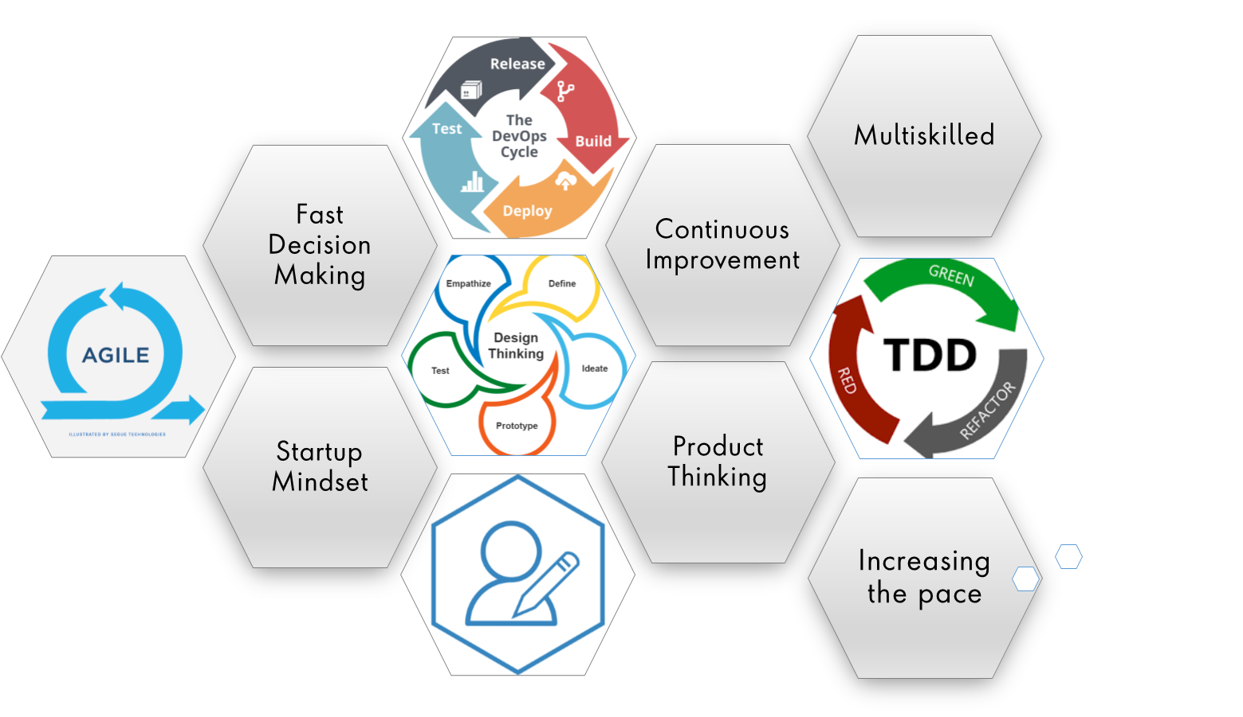
Notes:
Product Thinking (Design Thinking, Requirement Analysis, )
Multi Skilled (Frontend, Backend, DevOps)
Fast Decision Making (Agile)
Increasing the Pace (Automation CI/CD)
Startup Mindset (Agile)
Continuous Improvement (Retros)

Slide 18
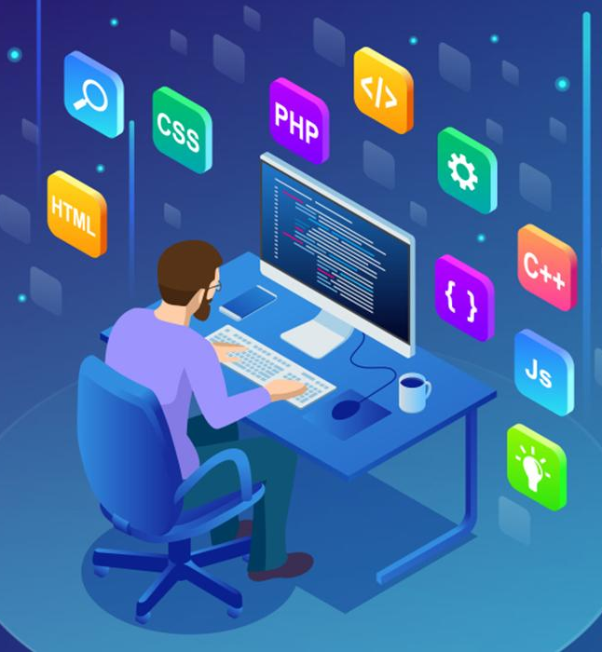
Tech Stack
Notes:
Time – 2 mins

Slide 19








Framework
SQL Database
SCM
Repository
IDE
API TESTING
Language
Notes:
Time – 1 min

Slide 20

Development
Notes:
Time – 1 min

Slide 21
Go over backlog items
present new updates and feedbacks
Requirement understanding
Research and analysis
Estimation
Sprint Planning
Spring Grooming
Delivery
Sprint Implementation
LLD
Development
Code Review
Commit
Integrate
Deploy
Test
Notes:
Time – 1 min

Slide 22

Challenges
-Making api calls for different operations.
Learnings
-Got to learn new technologies.
-Learnt working together in team.
-Learnt how to write code which is accepted by the industry.
-Learnt how to make UML diagrams for the given problem.
Notes:
Time – 2 mins
Challenges-
Installing the Tomcat server and running application on it.
Learnings-
Got to learn new technologies.
Learnt working together in teams.(collaboration)
Learnt how to write code which is accepted by the industry.
Learnt how to make UML diagrams for the given problem.

Slide 23

Demo
Notes:
Time –
POS- Student -5 min
REST - Professor - 3 min
DropWizard- 3 min

Slide 24

Questions
Notes:
Time - ?

Slide 25
Thank you
Notes:
Time – After this show the testimonial video. 1 min

